Slide 1
Gaining of Skills for Development of Educational Software
Damir Kalpić Jasna Hamzabegović
University of Zagreb University of Bihać
Faculty of Electrical Engineering Pedagogical Faculty
and Computing Department of Mathematics (FER) and Informatics
Croatia Bosnia and Herzegovina
13th WorkShop DAAD
Bansko, 26-31.8.2013.

Slide 2
Presentation overview
Overview
INTRODUCTION
The Educational Software
IDENTIFIED ISSUES
STUDENTS AS CREATORS OF EDUCATIONAL SOFTWARE
STUDENTS‘ CONTRIBUTION TO THE DEVELOPMENT OF EDUCATIONAL SOFTWARE
CONCLUSION
13th WorkShop DAAD
Bansko, 26-31.8.2013.

Slide 3
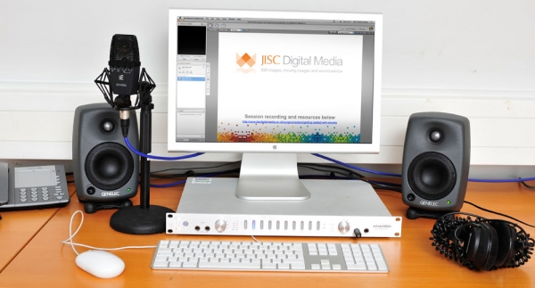
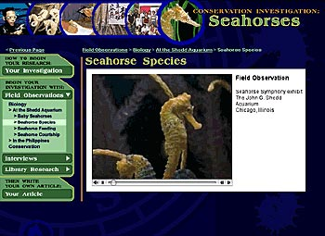
Historically:
Introduction
The Education
Educational materials include text
CURRENTLY :
Educational materials include images, audio and video clips.
13th WorkShop DAAD
Bansko, 26-31.8.2013.

Slide 4
The development of IT
Introduction
The Education
Enables teachers to offer educational materials which include multimedia.
The development of ICT
Enables teachers to publish educational materials on the website of the Faculty.
Enables students to take it on their computer or mobile phone.
Multimedia learning
is
interesting and appealing
13th WorkShop DAAD
Bansko, 26-31.8.2013.

Slide 5
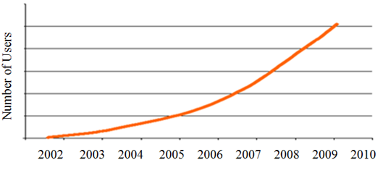
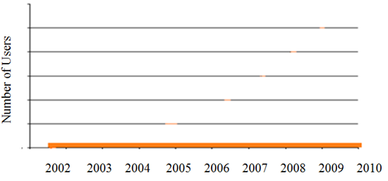
in the world Growth of number of users
Introduction
The EducationAL SOFTWARE
http://en.wikiversity.org/wiki/Open_educational_resources
http://www.huffingtonpost.com/2012/11/02/maines-decade-old-school-_n_2064818.html
Number of users of educational software in Bosnia and Herzegovina
No information on the Internet
13th WorkShop DAAD
Bansko, 26-31.8.2013.

Slide 6
STUDENTS AS CREATORS OF EDUCATIONAL SOFTWARE
IT studies at the educational colleges :
generally fall into a group of secondary studies,
educate future teachers.
At the Pedagogical Faculty within the University of Bihać
exists the Department offering specialisation track in Mathematics and Informatics.
The aim of the study at this Faculty is to produce:
modern informatics teachers
&
teachers with practical knowledge and programming skills who can create interactive educational software.
13th WorkShop DAAD
Bansko, 26-31.8.2013.

Slide 7
STUDENTS AS CREATORS OF EDUCATIONAL SOFTWARE
)
The current curriculum :
succeeded to teach students without any prior programming knowledge ,
in only three semesters,
to develop simple Windows Presentation Foundation (WPF) and Silverlight applications.
Ideas for future :
All the students can create their own WPF applications.
The initiative that the new curriculum introduces a course called Programming of educational applications.
This course is not taught on any other pedagogical faculty in Bosnia and Herzegovina.
The curriculm of the Pedagogical faculty consists of the following IT courses: Introduction to Computing-I semester, Algorithms and Programming-II sem, Programming Languages​​1, Databases-III sem, Programming Languages2, 2D Computer Graphics and Multimedia-IV sem, Programming Windows Applications, 3D Computer Graphics-V sem, Programming Educational Applications, Computer Networks and Internet-VI sem, Web Programming-VII sem, Website Design-VIII sem and the following pedagogy related courses : Pedagogy, General Psychology, Educational Psychology, Didactics and Teaching Methods
13th WorkShop DAAD
Bansko, 26-31.8.2013

Slide 8
STUDENTS AS CREATORS OF EDUCATIONAL SOFTWARE
)
The current status:
There will be presented some of the student applications.
They are rich with multimedia : images, sound, video and animations.
Ideas for applications :
The topics covered in the presented pilot applications were chosen by students themselves, based on their personal preferences (mathematics, games for kindergarten children, etc.).
13th WorkShop DAAD
Bansko, 26-31.8.2013

Slide 9
STUDENTS AS CREATORS OF EDUCATIONAL SOFTWARE
The technology :
Microsoft .NET Framework
Windows Presentation Foundation (WPF)
Silverlight
Microsoft Visual Studio development environment for professional programmers
13th WorkShop DAAD
Bansko, 26-31.8.2013

Slide 10
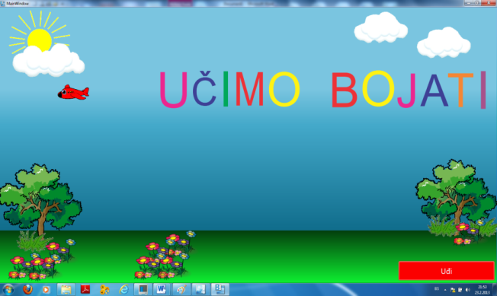
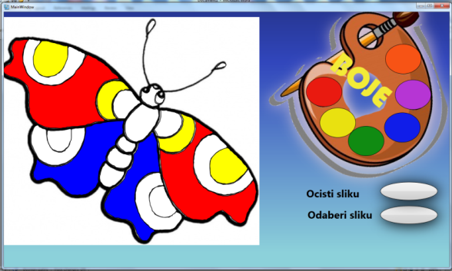
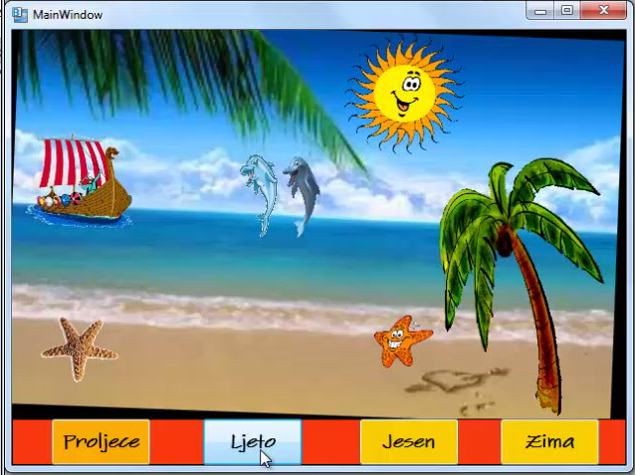
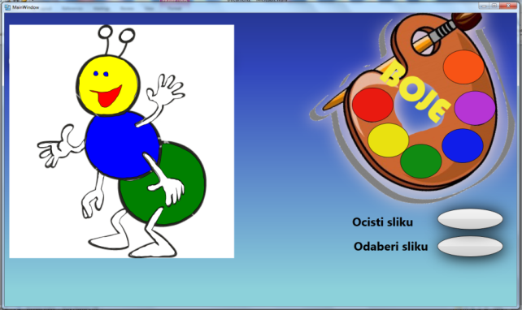
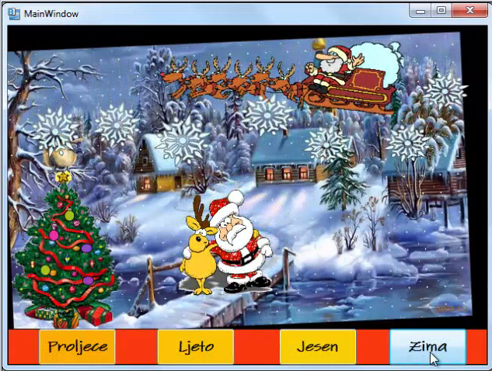
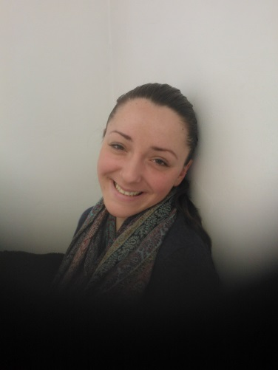
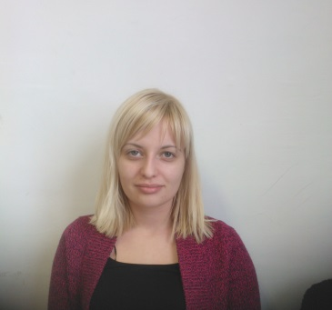
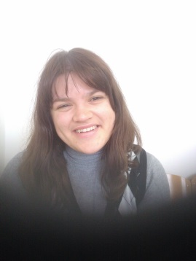
STUDENTS‘ CONTRIBUTION TO THE DEVELOPMENT OF EDUCATIONAL SOFTWARE

Slide 11
STUDENTS‘ CONTRIBUTION TO THE DEVELOPMENT OF EDUCATIONAL SOFTWARE

Slide 12
STUDENTS‘ CONTRIBUTION TO THE DEVELOPMENT TO THE DEVELOPMENT OF EDUCATIONAL SOFTWARE
The determinant
The cube
The conversion
The seasons

Slide 13
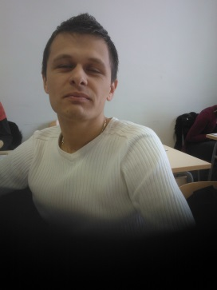
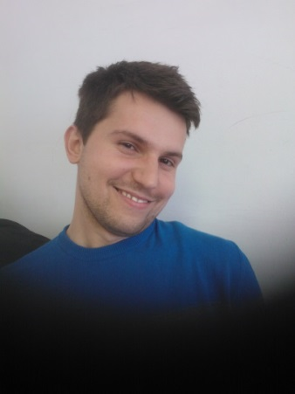
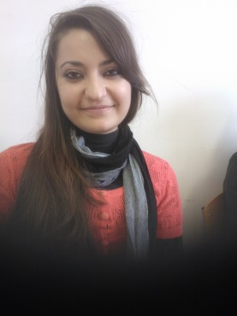
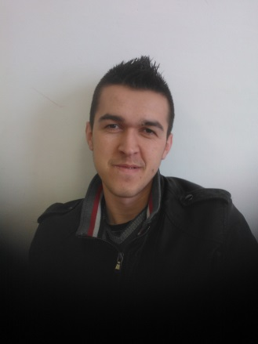
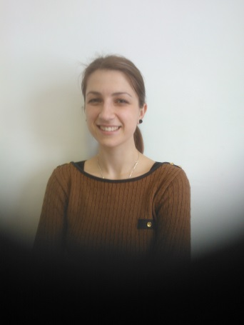
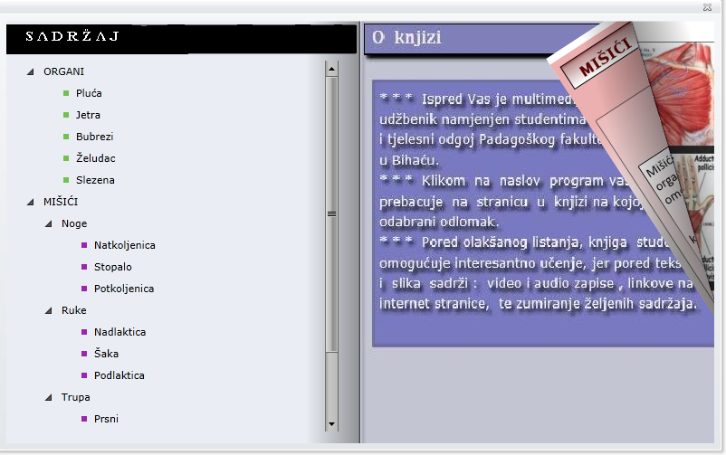
ELECTRONIC MULTIMEDIA AND INTERACTIVE BOOK
STUDENTS‘ CONTRIBUTION TO THE DEVELOPMENT OF EDUCATIONAL SOFTWARE
high quality graphics
lot of pictures, audio and video clips, and animations
virtual scrolling
positioning directly by clicking on the title in the Table of Contents.
DEVELOPMENT TOOLS:
VisualStudio 2010
MS Expression Blend 4

Slide 14
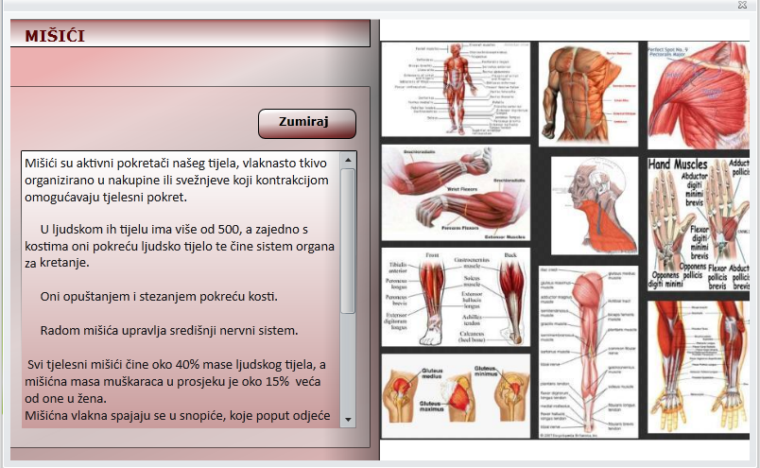
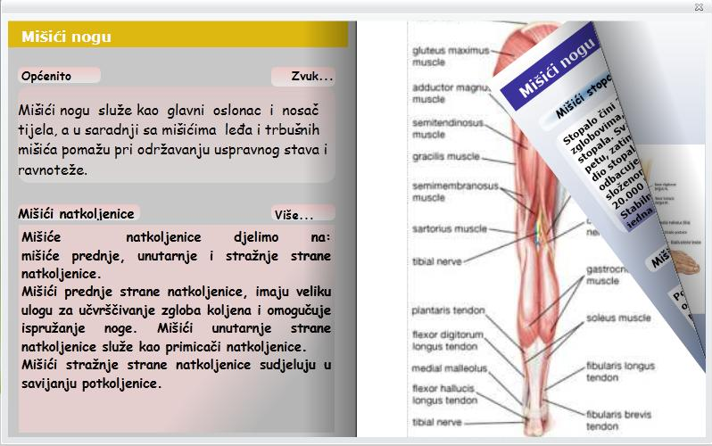
Electronic Multimedia Interactive Book
STUDENTS‘ CONTRIBUTION TO THE DEVELOPMENT OF EDUCATIONAL SOFTWARE
Allows you to display text
Allows you to scroll through a large-scale text
Quality pictures
Reproduction of textual content in the form of audio recordings

Slide 15
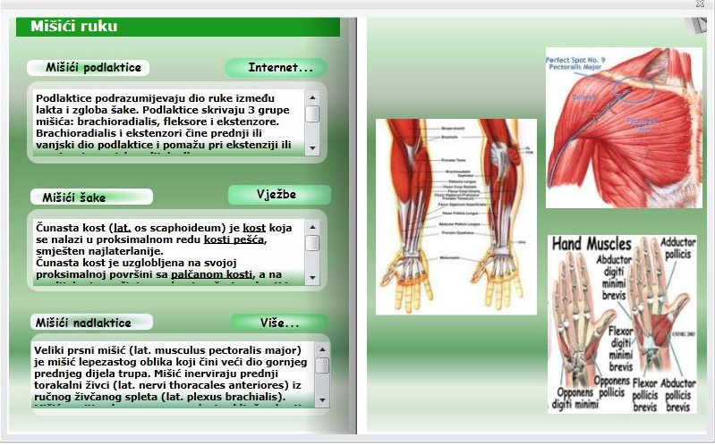
Electronic Multimedia Interactive Book
STUDENTS‘ CONTRIBUTION TO THE DEVELOPMENT OF EDUCATIONAL SOFTWARE
Links to relevant websites
Video clips of exercises
Link to pdf or word file with the education text on the college server
13th WorkShop DAAD
Bansko, 26-31.8.2013.

Slide 16
STUDENTS‘ CONTRIBUTION TO THE DEVELOPMENT OF EDUCATIONAL SOFTWARE

Slide 17
CONCLUSION :
The students are our main resource.
They can be included in the process of creating educational software also for children with specific learning disabilities.
It is necessary to provide the students‘ co-operation with educational and rehabilitation experts, with psychologists and pedagogues.
13th WorkShop DAAD
Bansko, 26-31.8.2013.

Slide 18
Thank you
for your attention!
13th WorkShop DAAD
Bansko, 26-31.8.2013.

